Slide 1
Introduction to Data Analysis

Slide 2
DATA INSIGHT FUNDAMENTALS
Patrick Boily Data Action Lab | uOttawa | Idlewyld Analytics
pboily@uottawa.ca
[with files from Jen Schellinck | Sysabee]

Slide 3

“Reports that say that something hasn't happened are always interesting to me, because as we know, there are known knowns; there are things we know that we know. There are known unknowns; that is to say, there are things that we now know we don't know. But there are also unknown unknowns – there are things we do not know we don't know.”
Donald Rumsfeld, US Department of Defense News Briefing, 2002

Slide 4
ANALYSIS PLANNING
DATA INSIGHT FUNDAMENTALS
“Plans are nothing. Planning is everything.”
Dwight D. Eisenhower

Slide 5
ANALYSIS PLAN OVERVIEW
[CDC, Creating an Analysis Plan]
Formulate research questions/hypotheses
Identify necessary (and available) datasets
Establish inclusion/exclusion criteria for records/observations
Select variables for use in the analyses
Chose statistical methods and software

Slide 6
DATA 101: BASIC DATA CONCEPTS
DATA INSIGHT FUNDAMENTALS
“You can have data without information, but you cannot have information without data.”
Daniel Keys Moran (attributed)

Slide 7
WHAT IS DATA?
4,529 ‘red’ 25.782 ‘Y’

Slide 8
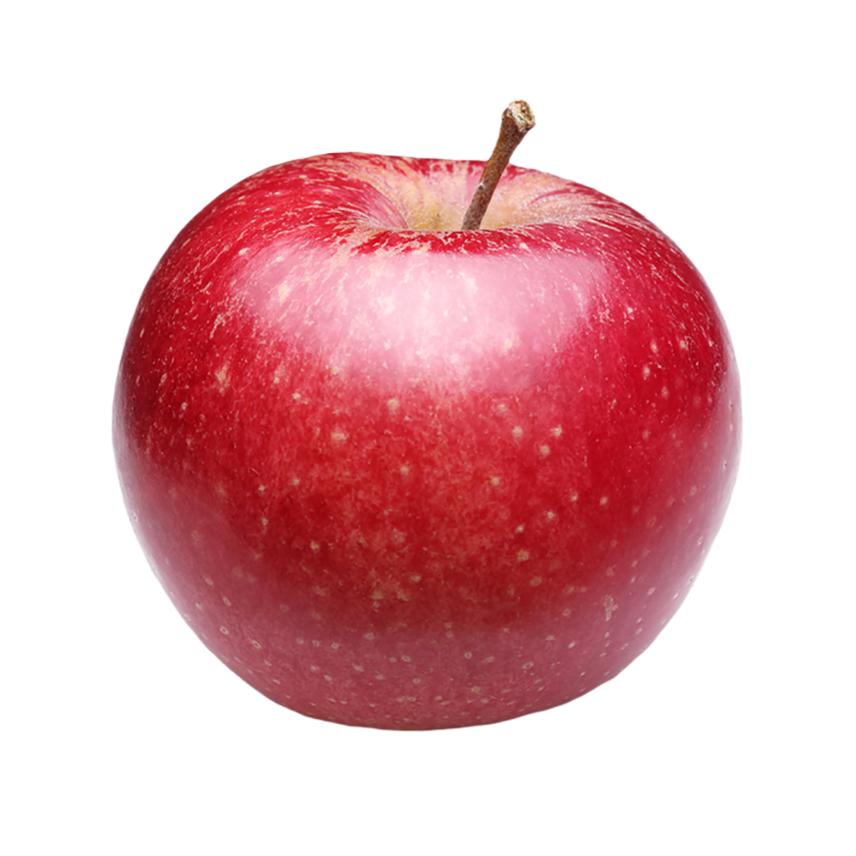
OBJECTS AND ATTRIBUTES
Object: apple
Shape: spherical
Colour: red
Function: food
Location: fridge
Owner: Jen
Remember: a person or an object is not simply the sum of its attributes!

Slide 9
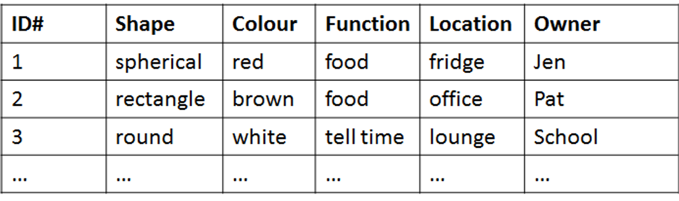
FROM ATTRIBUTES TO DATASETS
Attributes are fields (columns) in a database; objects are instances (rows).
Objects are described by their feature vector, the collection of attributes associated with value(s) of interest.

Slide 10
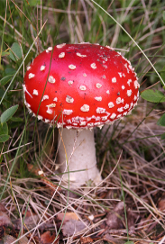
POISONOUS MUSHROOM DATASET
[https://archive.ics.uci.edu/ml/datasets/Mushroom]
Amanita muscaria
Habitat: woods Gill Size: narrow Odor: none Spores: white Cap Colour: red
Classification problem: Is Amanita muscaria edible, or poisonous?

Slide 11
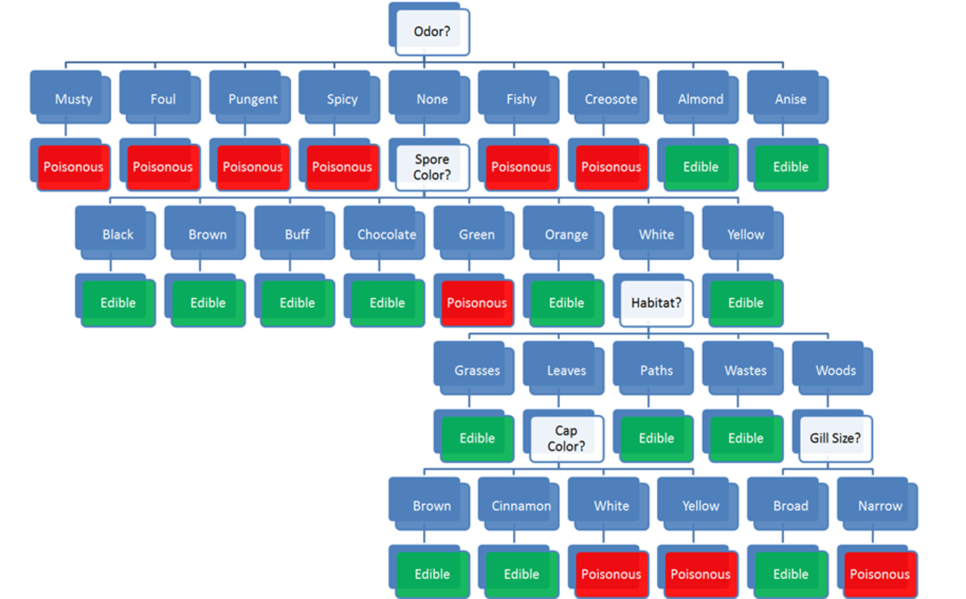
Habitat: woods
Gill Size: narrow
Odor: none
Spores: white
Cap Colour: red
Classification problem: edible or poisonous?

Slide 12
Habitat: woods
Gill Size: narrow
Odor: none
Spores: white
Cap Colour: red
Classification problem: edible or poisonous?

Slide 13
Habitat: woods
Gill Size: narrow
Odor: none
Spores: white
Cap Colour: red
Classification problem: edible or poisonous?

Slide 14
Habitat: woods
Gill Size: narrow
Odor: none
Spores: white
Cap Colour: red
Classification problem: edible or poisonous?

Slide 15
Habitat: woods
Gill Size: narrow
Odor: none
Spores: white
Cap Colour: red
Classification problem: edible or poisonous?

Slide 16
Habitat: woods
Gill Size: narrow
Odor: none
Spores: white
Cap Colour: red
Classification problem: edible or poisonous

Slide 17
DISCUSSION
Would you have trusted an “edible” prediction?
Where is the model coming from?
What would you need to know to trust the model?
What’s the cost of making a classification mistake, in this case?

Slide 18
ASKING THE RIGHT QUESTIONS
Data science is really about asking and answering questions:
Analytics: “How many clicks did this link get?”
Data Science: “Based on this user’s previous purchasing history, can I predict what links they will click on the next time they access the site?”
Data mining/science models are usually predictive (not explanatory): they show connections, but don't reveal why these exist.
Warning: not every situation calls for data science, artificial intelligence, machine learning, statistics, or analytics.

Slide 19
THE WRONG QUESTIONS
Too often, analysts are asking the wrong questions:
questions that are too broad or too narrow
questions that no amount of data could ever answer
questions for which data cannot reasonably be obtained
The best-case scenario is that stakeholders will recognize the answers as irrelevant.
The worst-case scenario is that they will erroneously implement policies or make decisions based on answers that have not been identified as misleading and/or useless.

Slide 20
DATA SCIENCE/MACHINE LEARNING AUGMENTED INTELLIGENCE TASKS
Classification and class probability estimation: which clients are likely to be repeat customers?
Clustering: do diplomatic missions form natural groups?
Association rule discovery: what books are commonly purchased together?
Others:
profiling and behaviour description; link prediction; value estimation/regression analysis (how much is a client likely to spend in a restaurant?); similarity matching (which prospective clients are similar to a company's best clients?); data reduction; influence/causal modeling, anomaly detection, time series analysis, etc.

Slide 21
SOME PRACTICAL DEFINITIONS
DATA INSIGHT FUNDAMENTALS
“What’s in a name? That which we call a rose By any other name would smell as sweet.”
W. Shakespeare, Romeo and Juliet, Act II, Scene 2

Slide 22
WHAT IS DATA ANALYSIS?
Finding patterns in data
Using data to do something (answer a question, assist in decision-making, predict a future occurrence, draw a conclusion)
Creating models of the data
Describing or explaining a situation (the system)
(Testing (scientific) hypotheses?)
(Carrying out calculations on data?)

Slide 23
WHAT IS DATA SCIENCE?
Data science is the collection of processes by which we extract useful and actionable insights from data.
T. Kwartler (paraphrased)
Data science is the working intersection of statistics, engineering, computer science, domain expertise, and “hacking.” It involves two main thrusts: analytics (counting things) and inventing new techniques to draw insights from data.
H. Mason (paraphrased)

Slide 24
WORKFLOWS and Pipelines
DATA INSIGHT FUNDAMENTALS
“All models are wrong. Some models are useful.”
George Box

Slide 25
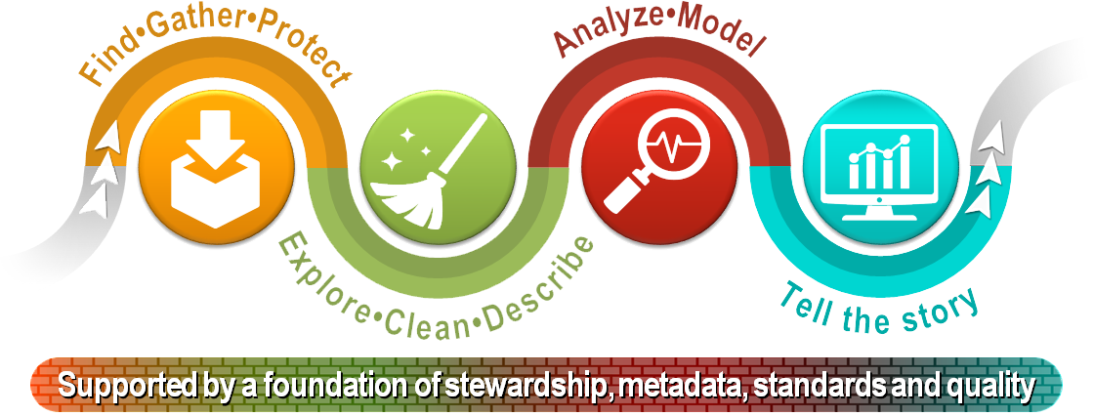
[StatCan, Steps of the Data Journey]

Slide 26
THE DATA SCIENCE WORKFLOW
Objective/
Rationale
Utilization and Decision Support
Data Collection
Data Exploration
Infrastructure and Data Management
Data Preparation
Modeling and Analysis
Communication

Slide 27
THE DATA SCIENCE WORKFLOW
Objective/
Rationale
Utilization and Decision Support
Data Collection
Data Exploration
Infrastructure and Data Management
Data Preparation
Modeling and Analysis
Communication

Slide 28
THE DATA ANALYSIS PROCESS
A large number of analytical models have to be generated before a final selection can be made.
Iterative process: feature selection and data reduction may require numerous visits to domain experts before models start yielding promising results.
Domain-specific knowledge has to be integrated in the models in order to beat random classifiers and clustering schemes, on average.

Slide 29
LIFE AFTER ANALYSIS
When an analysis or model is ‘released into the wild’, it can take on a life of its own.
Analysts may eventually have to relinquish control over dissemination. Results may be misappropriated, misunderstood, or shelved. What can the analyst do to prevent this?
Finally, because of analytic decay, it’s important to view the last analytical step NOT as a static dead end, but rather as an invitation to return to the beginning of the process.

Slide 30
DATA SCIENCE ECOSYSTEM
Data analysis is a team sport, with team members needing a good understanding of both data and context
data management
data preparation
analysis
communications
Even slight improvements over a current approach can find a useful place in an organization – data science is not solely about Big Data and disruption!

Slide 31
MODEL ASSESSMENT AND VALIDITY
Models should be current, useful, and valid.
Data can be used in conjunction with existing models to come to some conclusions or can be used to update the model itself.
At what point does one determine that the current data model is out-of-date or is not useful anymore?
Past successes can lead to reluctance to re-assess/re-evaluate a model.

Slide 32
MODELS AND SYSTEMS THINKING
DATA INSIGHT FUNDAMENTALS
“What if the only valid model of the Universe is the Universe itself?”
Unknown

Slide 33
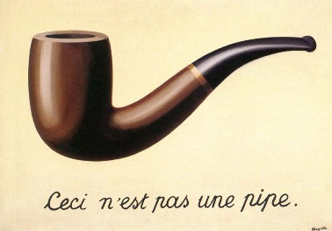
REPRESENTATIONS
A representation is an object that stands in for another object.
A representation may or may not physically resemble the object it represents.
Representations of the world help us to understand, navigate, and manipulate the world.

Slide 34
[J. Schellinck]

Slide 35
THINKING IN SYSTEMS TERMS
A system is made up of objects with properties that potentially change over time. Within the system we perceive actions and evolving properties leading us to think in terms of processes.
We observe, quantify, and record particular values of these properties at particular moments in time.
This generates data points, capturing the underlying reality that the system approximates to some degree of accuracy and error.

Slide 36
IDENTIFYING GAPS IN KNOWLEDGE
A gap in knowledge is identified when we realize that what we thought we knew about a system proves incomplete (or false).
This might happen repeatedly, at any moment in the process:
data cleaning
data consolidation
data analysis
The solution is to be flexible. When faced with such a gap, go back, ask questions, and modify the system representation.

Slide 37
CONCEPTUAL MODELING
Exercise:
an acquaintance has just set foot in your living space for the first time
you are on the phone with them but not currently at home
explain to them how to go about changing a breaker
(how would you do so if the acquaintance was visually impaired?)
Conceptual models are built using methodical investigation tools
diagrams
structured interviews
structured descriptions
etc.

Slide 38
RELATING THE DATA TO THE SYSTEM
Is the data which has been collected and analyzed going to be of any use when it comes to understanding the system?
This question can only be answered if we understand:
how the data is collected
the approximate nature of both data and system
what the data represents (observations and features)
Is the combination of system and data sufficient to understand the aspects of the world under consideration?

Slide 39
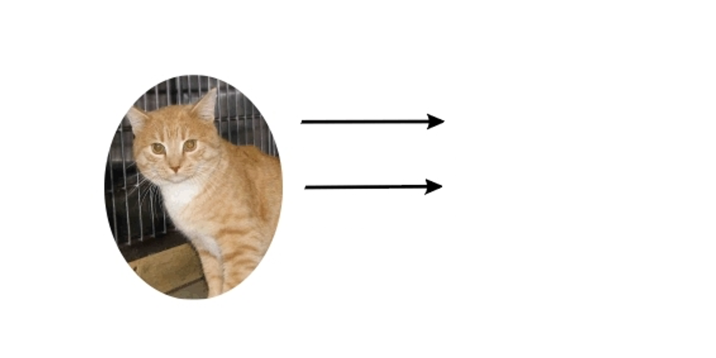
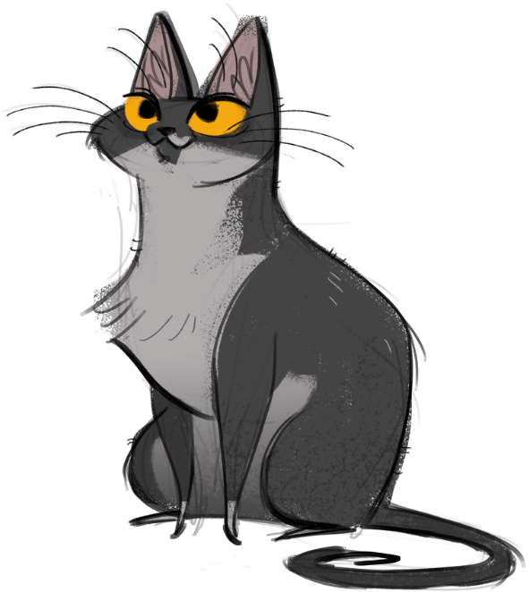
[http://dailycatdrawings.tumblr.com; #309]
Real World
Model
Theory
Identification of details relevant to description and translation of real-world objects into model variables

Slide 40
TAKE-AWAYS
Systems can approximate certain aspects of the Universe.
System models provide the basis under which data is identified and collected, but data itself is approximate and selective.
Knowledge gaps happen – be ready to re-visit your set-up regularly.
Implicit conceptual modeling can lead to problematic situations.
If the data, the system, and the world are out of alignment, data analysis insights might ultimately prove useless.

Slide 41
ETHICAL CONSIDERATIONS & BEST PRACTICES
DATA INSIGHT FUNDAMENTALS
“We have flown the air like birds and swum the sea like fish but have yet to learn the simple act of walking the Earth like brothers.”
Martin Luther King, Jr.

Slide 42
What harm can come from data?

Slide 43
THE NEED FOR ETHICS
Formerly: “Wild West” mentality to data collection (and use). Whatever wasn’t technologically forbidden was allowed.
Now: professional codes of conduct are being devised for data scientists (outline responsible ways to practice data science).
Additional responsibility for data scientists; but also, protection against being hired to carry out questionable analyses.

Slide 44
WHAT ARE ETHICS?
Broadly speaking, ethics refers to the study and definition of right and wrong conducts:
“not […] social convention, religious beliefs, or laws”. (R.W. Paul, L. Elder)
Influential ethical theories:
Kant's golden rule (do onto others…), consequentialism (the ends justify the means), utilitarianism (act in order to maximize positive effect), etc.
Confucianism, Taoism, Buddhism (?), etc.
Ubuntu, Maori, etc.

Slide 45
WHAT ARE ETHICS?
[OCAP® is a registered trademark of the First Nations Information Governance Centre (FNIGC)]
First Nations Principles of OCAP®:
Ownership cultural knowledge, data, and information is owned by communities
Control communities have the right to control all aspects of research and information management that impact them
Access communities must have access to information and data about themselves no matter where it is held
Possession communities must have physical control of relevant data

Slide 46
ETHICS IN THE DATA CONTEXT
[University of Virginia, Centre for Big Data Ethics, Law, and Policy]
Data ethics questions:
Who, if anyone, owns data?
Are there limits to how data can be used?
Are there value-biases built into certain analytics?
Are there categories that should not be used in analyzing personal data?
Should some data be publicly available to all researchers?
Analytically, the general is preferred to the anecdotal – decisions made on the basis of machine learning and A.I. (security, financial, marketing, etc.) may affect real beings in unpredictable ways.

Slide 47
BEST PRACTICES
“Do No Harm”: data collected from an individual should not be used to harm the individual.
Informed Consent:
Individuals must agree to the collection and use of their data
Individuals must have a real understanding of what they are consenting to, and of possible consequences for them and others
Respect “Privacy”: excessively hard to maintain in the age of constant trawling of the Internet for personal data.

Slide 48
BEST PRACTICES
[More information on how to consider data privacy and human rights is found in the Intranet Data Wiki.]
Keep Data Public: data should be kept public (all? most? any?).
Opt-In/Opt-Out: Informed consent requires the ability to opt out.
Anonymize Data: removal of id fields from data prior to analysis.
“Let the Data Speak”:
no cherry picking
importance of validation (more on this later)
correlation and causation (more on this later, too)
repeatability

Slide 49
GBA+
[https://www.statcan.gc.ca/eng/topics-start/gender_diversity_and_inclusion]
Gender-Based Analysis Plus is an analytical process used to assess how different gendered people may experience policies, programs and initiatives.
Example: Work interruptions and financial vulnerability, D. Messacar, R. Morrissette
If the data had not been collected and/or analyzed in a GBA+ manner, it would be harder to see how financial vulnerability affects different groups (if the analysis had looked only at age groups and gender, for example, instead of also including family composition).
Policies and events impact real people in real way, and not always in the same manner. Data analysis methods are typically used to predict and/or describe average (or central) outcomes, but it is often those who are far from the centre who are most affected.
Let’s be smart about this.

